Slide 1
Mindfulness
Helping the Mind During a Pandemic
“Everything that has a beginning has an ending. Make your peace with that and all will be well.” – Jack Kornfield
“Mindfulness is the practice of maintaining a nonjudgmental state of heightened or complete awareness of one’s thoughts, emotions, or experiences on a moment-to-moment basis,” (Moore 2019).
It is an innate ability we can harness through practice. There is no “correct” way to feel while in the absence of judgement.
Notes:
https://positivepsychology.com/what-is-mindfulness/
https://www.mindful.org/what-is-mindfulness/

Slide 2
Outline
What is COVID-19?
Effects of isolation on self and society
How to help oneself during quarantine
What is mindfulness and its benefits
Mindfulness in quarantine
Mindfulness in college
Mindfulness in pharmacy
Notes:
Image: https://www.goodskins.com/peaceful_waterfall/

Slide 3
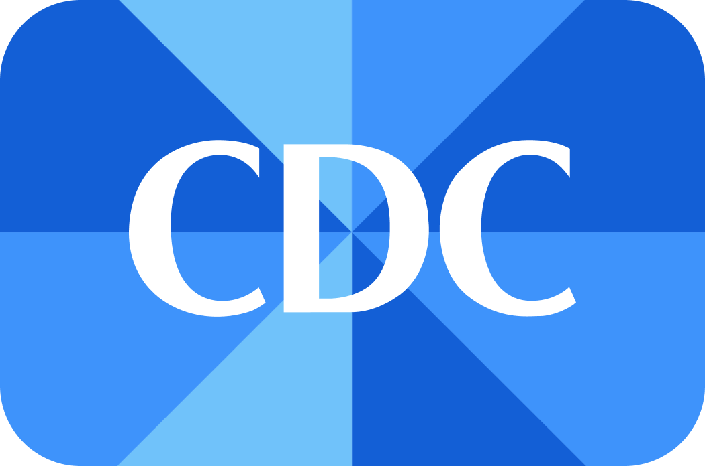
What is COVID-19?
COVID-19 is coronavirus causing respiratory illness
Official name is SARS-CoV-2
The virus is spread from person to person within six feet of each other
The coronavirus family originates from people and animals
Breakdown of the name:
“CO” for Corona
“VI” for Virus
“D” for disease
“19” for 2019
Notes:
“Frequently Asked Questions.” Centers for Disease Control and Prevention, Centers for Disease Control and Prevention, 11 Apr. 2020, www.cdc.gov/coronavirus/2019-ncov/faq.html#Coronavirus-Disease-2019-Basics.

Slide 4
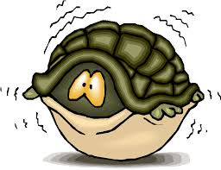
Effects of Isolation
Changes in sleep or eating patterns
A loss or shift of routine makes it harder to build healthy habits into our days, such as eating healthy meals or going to bed at a reasonable hour
More likely to turn to bad habits
There is less pressure from outside sources, such as family, friends, or peers, to stay away from bad habits such as smoking or drinking
Difficulting concentrating during tasks
Many people find themselves distracted in a different environment and have trouble completing work. This can result in poor work quality and lower grades for those in school.
Worsening of chronic health conditions, including mental health conditions
With limited access to healthcare providers and support, those who struggle with chronic health conditions are having difficulty taking care of their condition
Notes:
Novotney, Amy. “The Risks of Social Isolation.” Monitor on Psychology, American Psychological Association, May 2019, www.apa.org/monitor/2019/05/ce-corner-isolation.
“Mental Health and Coping During COVID-19.” Centers for Disease Control and Prevention, Centers for Disease Control and Prevention, 1 Apr. 2020, www.cdc.gov/coronavirus/2019-ncov/daily-life-coping/managing-stress-anxiety.html.
Image: https://side-out.org/patient-reflections-learning-about-cancer/dealing-with-fear/

Slide 5
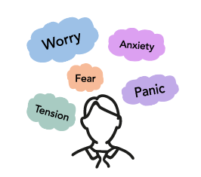
Negative Thoughts
Fear and Anxiety
Many people project their nervous and fearful energy towards racial slang and targeting hateful comments and actions towards international people in the United States, particularly of people from the country of origin of the virus
Notes:
“Frequently Asked Questions.” Centers for Disease Control and Prevention, Centers for Disease Control and Prevention, 11 Apr. 2020, www.cdc.gov/coronavirus/2019-ncov/faq.html#Coronavirus-Disease-2019-Basics.
Image: https://www.mindwell-leeds.org.uk/myself/feeling-unwell/anxiety

Slide 6
Rise Above Racism and Stigma
Stigma
“Stigma is discrimination against an identifiable group of people, a place, or a nation. Stigma is associated with a lack of knowledge about how COVID-19 spreads, a need to blame someone, fears about disease and death, and gossip that spreads rumors and myths” (CDC 2020).
Stigma causes people to hurt others physically and mentally, spread the fear and anxiety of the pandemic, and shifts the focus from the actual problem
It is important to understand this problem impacts everybody, and cannot be blamed on a person or group of people
Notes:
Picture: https://clipartstation.com/college-students-working-together-clipart-clipartxtras-for-college-students-working-together-clipart/

Slide 7
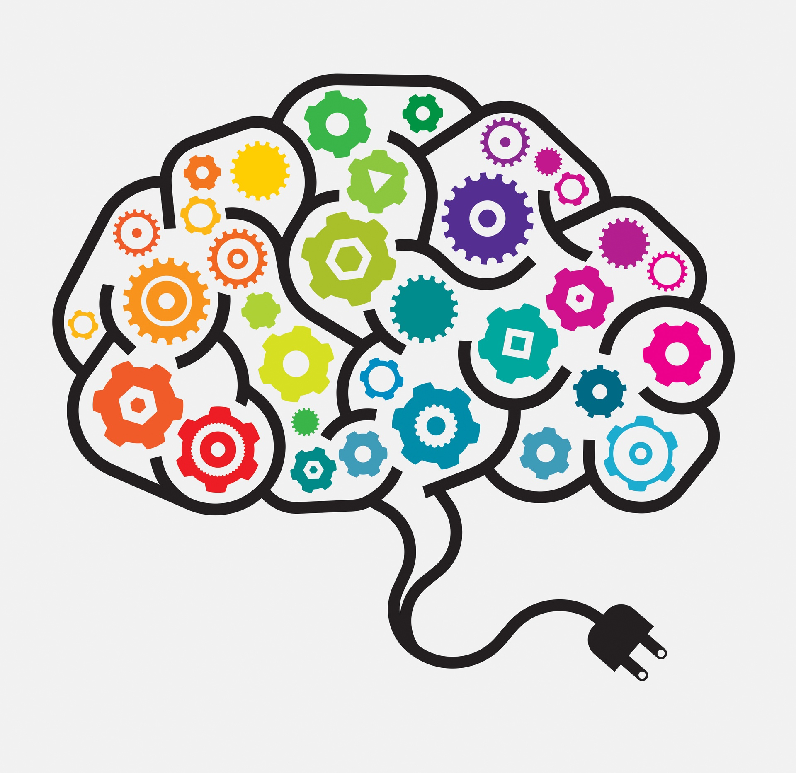
Why it is okay to feel overwhelmed, stressed, and socially deprived?
Everyone reacts differently to stressful situations
Your situations are different than the situations of your peers. This makes your response to COVID-19 and other situations different than others.
Having many contradicting sources of information makes it hard to truly understand how to protect yourself in the best way
In a digital age, is tough to keep up with all the information going around and understanding what is accurate and what is not
A pandemic of this magnitude has never been seen in our lifetimes
This is a new experience for everyone, and no one knows exactly what will happen
Notes:
“Mental Health and Coping During COVID-19.” Centers for Disease Control and Prevention, Centers for Disease Control and Prevention, 1 Apr. 2020, www.cdc.gov/coronavirus/2019-ncov/daily-life-coping/managing-stress-anxiety.html.
Image: https://shawellnessclinic.com/en/shamagazine/brain-gym/

Slide 8
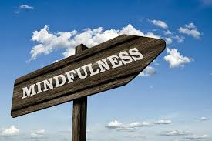
How can I help myself during quarantine?
Practicing mindfulness techniques can reground your thinking
Mindfulness is often the first step of reorienting yourself in a panicked state of mind
Cognitive behavioral therapy by professionals online
UCONN’s mental health resources
Notes:
https://positivepsychology.com/benefits-of-mindfulness/
Image: https://www.needpix.com/photo/365841/mindfulness-signs-sky-clouds

Slide 9
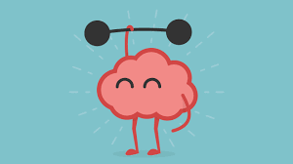
Benefits of Mindfulness
What is Mindfulness Meditation?
“Mindfulness meditation gives us a time in our lives when we can suspend judgment and unleash our natural curiosity about the workings of the mind, approaching our experience with warmth and kindness—to ourselves and others,” (“What is Mindfulness?” 2019).
What can Mindfulness do for you?
Reduce Stress from the pandemic
Improve Performance
Gain insight into ourselves
Improve attention to other’s well being
Promote self-awareness
Notes:
https://www.mindful.org/what-is-mindfulness/
Image: https://www.mayoclinichealthsystem.org/hometown-health/speaking-of-health/5-tips-to-keep-your-brain-healthy

Slide 10
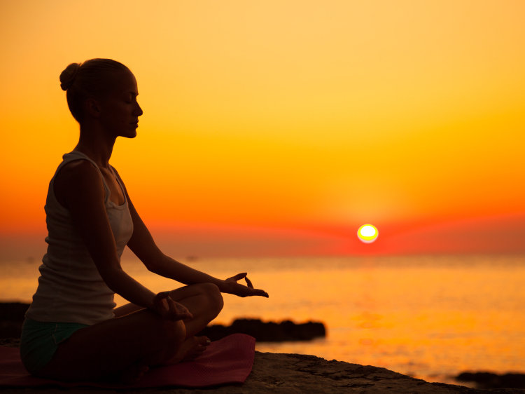
Mindfulness Benefits Continued
Stress Reduction:
Practice emotional regulation, can lead to more stable mood patterns
Unconventional therapy:
Example: A helpful tool for college students in reducing pressure of “fitting in” with societal norms of the college scene (drinking, partying, etc.)
Management:
Mindfulness is shown to have benefits in helping manage one’s daily life, and even to help cope better with symptoms of illness or hard life experiences
Helping Depression:
Can be a tool to help address and work through/regulate negative emotions
Reducing anxiety:
Mindfulness aids in healthier brain function, lower heart rate, increased clarity, and reduced anxiety.
Notes:
https://positivepsychology.com/benefits-of-mindfulness/
Image: https://www.npr.org/sections/13.7/2015/07/21/424948567/does-mindfulness-mean-anything

Slide 11
Mindfulness Techniques
Basic Mindfulness Breathing:
Take deep, slow labored breaths and focus on the breaths; return all thoughts to the rhythm of breathing
Body sensation:
Notice and pay attention sensation on each part of your body. Allow the sensations to be there and observe without judgement
Emotions:
Allow thoughts and emotions to present themselves without judgement, accept them, and let them go.
Senses:
Use all your sense to notice as much as you can about the world around you; become grounded in reality
Notes:
https://www.helpguide.org/harvard/benefits-of-mindfulness.htm
Image: https://www.wallpaperflare.com/person-holding-clear-glass-glass-human-sphere-edisto-beach-sc-wallpaper-eectf

Slide 12
Mindfulness in Quarantine
During this trying time, are you finding yourself overwhelmed by the COVID-19 Pandemic? Try practicing mindfulness to calm your chaotic thoughts.
“Mindfulness is the practice of maintaining a nonjudgmental state of heightened or complete awareness of one’s thoughts, emotions, or experiences on a moment-to-moment basis,” (Moore 2019).
It is an innate ability we can harness through practice. There is no “correct” way to feel while in the absence of judgement.
Notes:
https://positivepsychology.com/what-is-mindfulness/
Image: https://www.proceilingtiles.com/ST-15107975.html

Slide 13
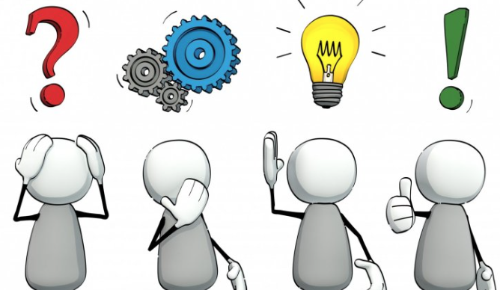
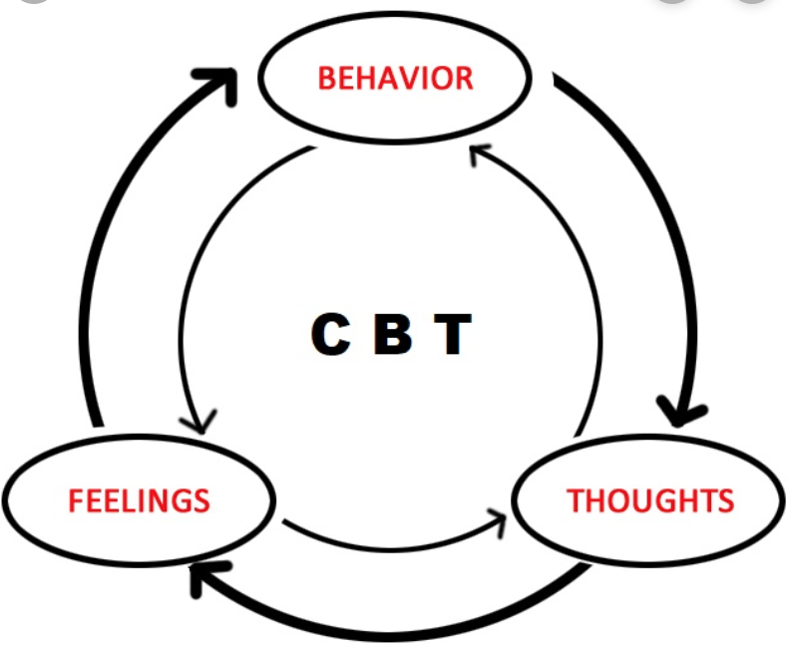
CBT Uses Mindfulness Techniques
CBT = cognitive behavioral therapy
invented in 1960s
changing perceptions
a short term, goal oriented treatment
hands on approach that can be achieved online during quarantine
goal is to target people’s difficulties and alter the way people think about them
emotional changes
thinking changes
behaviors changes
Notes:
“What Is Trauma-Focused Cognitive Behavioral Therapy?” Betterhelp, BetterHelp, 10 Oct. 2018.
“Mindfulness-Based Cognitive Therapy (MBCT).” Mindfulness–Based Cognitive Therapy, GoodTherapy, 3 Aug. 2018, www.goodtherapy.org/learn-about-therapy/types/mindfulness-based-cognitive-therapy.
Images: https://en.wikipedia.org/wiki/Cognitive_behavioral_therapy
https://www.facebook.com/pg/LetsDiscussItTogether/posts/

Slide 14
Core Belief Change Through CBT
CBT allows the changing of core beliefs
thinking about:
yourself
your future
others
this also includes physical sensations
removing unhelpful behaviors engrained in everyday life and altering them to be helpful
Notes:
“What Is Trauma-Focused Cognitive Behavioral Therapy?” Betterhelp, BetterHelp, 10 Oct. 2018.
“Mindfulness-Based Cognitive Therapy (MBCT).” Mindfulness–Based Cognitive Therapy, GoodTherapy, 3 Aug. 2018, www.goodtherapy.org/learn-about-therapy/types/mindfulness-based-cognitive-therapy.
Images: https://growinspiritmagazine.com/article/meditation-tips
https://www.canvasitup.com/products/canvas-wall-art-prints-purple-roses-on-black-stones-and-water-photo-print-picture-room-decoration-floral-pictures-photos-home?variant=40619099412

Slide 15
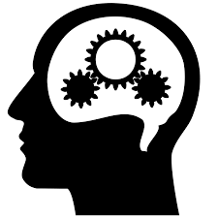
Practicing Mindfulness in College
Refocus and less substance abuse
Progress in therapy
College students are often posting on social media and focusing on their future career
College students are affected by this pandemic, shifting to online learning at home
Resetting our focus on the present allows us to form deeper connections with our community
College students are also more prone to drink excessively to cope with depression and stress
Study in 2016 at Louisiana State University shows students who practice mindfulness participate less in abusive drinking patterns
Combine cognitive methods and mindful meditation to gain better control over depression and anxiety
Notes:
https://www.collegian.psu.edu/lifestyles/health/article_58131944-104c-11e8-9e6d-9fd2ac28debc.html
https://www.goodtherapy.org/learn-about-therapy/types/mindfulness-based-cognitive-therapy
Image: https://webstockreview.net/explore/gears-clipart-human-mind/

Slide 16
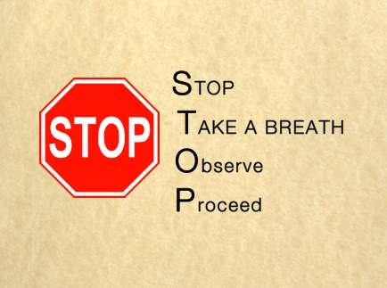
Mindfulness in Pharmacy
We work in a stressful profession with the high responsibility of handling patients’ prescriptions and counseling on a variety of disease states, including COVID-19
Interruptions, long work days, and volume of work may lead to negligence
Our new routine of cleaning and staying conscious of protecting ourselves and others from the virus can be mentally demanding
It is important to stay on task and provide optimal patient care
When you are overwhelmed, use STOP as a method of mindfulness
Take a moment away from the current situation to focus on your breathing
Observe and focus on a stimulus (your chair, object on the work counter)
You should feel yourself becoming more aware of your surroundings and self
Get back to the task you were on with a now less stressed, mindful approach
Notes:
Dr. Wheeler’s PHRX 5060 Skills notes
Images: https://www.huffpost.com/entry/stress-reduction-technique_b_2750736

Slide 17
Mindfulness Tips for COVID-19
When feeling overwhelmed about the pandemic, take the time to focus your mind on your breathing
Be present in the moment, relocate to a safe environment if necessary, and observe everything with your senses around you
Accept fearful and anxious thoughts without judgement, and let them go
Recollect your mind and body using mindfulness techniques after reading or watching the news
Limit time with triggering news sources that cause these anxious thoughts and retrieve information from credible sources like CDC
Recognize that taking time for mindfulness techniques and meditations is just as important in a pandemic as being up to date on current events
Notes:
https://www.helpguide.org/harvard/benefits-of-mindfulness.htm
Image: https://hbr.org/2019/01/how-mindfulness-can-help-engineers-solve-problems

Slide 18
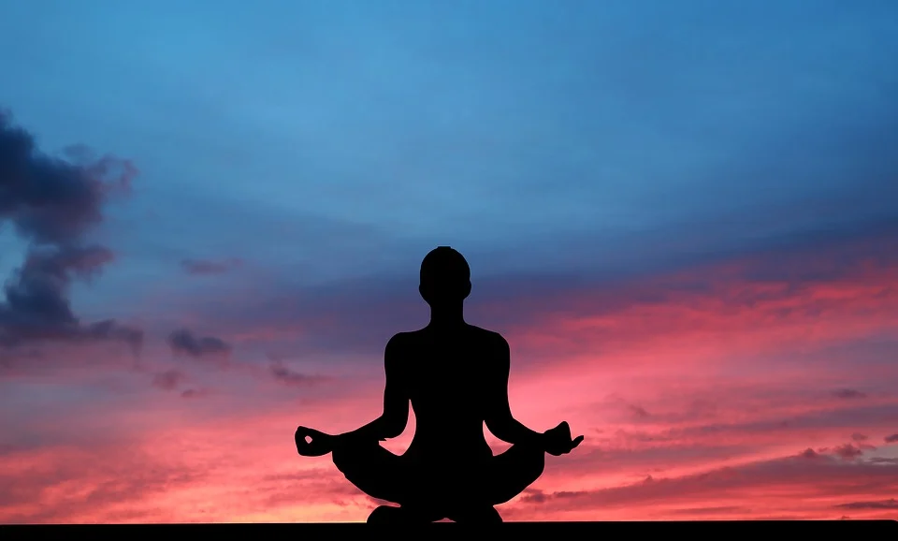
Let Us Practice
Go to a safe and quiet environment
Click this link to listen to relaxing music:
Mindfulness Meditation Music
Sit comfortably in a chair or cross-legged on a cushion
Relax and take a few moments for yourself to calm down
You may let your eyes close
Take deep, slow breaths and pay attention to the rhythm of your breathing
You may let your mind wander. Approach these thoughts without expectation or judgement.
Remember to:
Acknowledge sensations of the body without judgement
Take in all of your senses, and focus calmly on the visuals alone and notice texture, color, etc. if your eyes are open
Practicing mindfulness can be in short 5 minute intervals, or increased to 30 minutes
Notes:
Brantley, Jeffrey, et al. “How To Practice Mindfulness Meditation.” Mindful, 21 Oct. 2019, www.mindful.org/mindfulness-how-to-do-it/.
Wong, Cathy. “Mindfulness Meditation: What It Is and How to Practice.” Verywell Mind, Verywell Mind, 3 Apr. 2020, www.verywellmind.com/mindfulness-meditation-88369.
Image: https://pixabay.com/photos/sunset-yoga-zen-meditation-woman-4830931/

Slide 19
Summary
Isolation can have a toll on a person’s physical and mental health, but there are many resources and coping strategies to turn to during quarantine
It is easy to want to blame someone else for the spread of COVID-19, but it is best to focus on yourself and what you can do to keep yourself healthy
It is okay to feel overwhelmed and stressed during this this new and confusing time
Practicing mindfulness can help in both your personal and professional life
Notes:
Image: https://www.dwell.com/article/best-products-to-help-you-sleep-better-edd71191/6527203045694074880

Slide 20
References
Ackerman, Courtney. “23 Amazing Benefits of Mindfulness for Body and Brain”. Positive Psychology.com. 7 October,2019. https://positivepsychology.com/benefits-of-mindfulness/.
“Benefits of Mindfulness” : A Harvard Health article. HelpGuide . 2019. https://www.helpguide.org/harvard/benefits-of-mindfulness.htm.
Brantley, Jeffrey, et al. “How To Practice Mindfulness Meditation.” Mindful, 21 Oct. 2019, www.mindful.org/mindfulness-how-to-do-it/.
Dr. Kate Wheeler’s PHRX 5060 Skills Development notes on mindfulness
Fortin, Abby. “How Mindfulness Can Benefit College Students.” The Daily Collegian, 13 Feb. 2018, www.collegian.psu.edu/lifestyles/health/article_58131944-104c-11e8-9e6d-9fd2ac28debc.html.
“Frequently Asked Questions.” Centers for Disease Control and Prevention, Centers for Disease Control and Prevention, 11 Apr. 2020, www.cdc.gov/coronavirus/2019-ncov/faq.html#Coronavirus-Disease-2019-Basics.
Jaret, Peter, et al. “What Is Mindfulness?” Mindful, 26 July 2019, www.mindful.org/what-is-mindfulness/.
“Mental Health and Coping During COVID-19.” Centers for Disease Control and Prevention, Centers for Disease Control and Prevention, 1 Apr. 2020, www.cdc.gov/coronavirus/2019-ncov/daily-life-coping/managing-stress-anxiety.html.
“Mindfulness-Based Cognitive Therapy (MBCT).” Mindfulness–Based Cognitive Therapy, GoodTherapy, 3 Aug. 2018, www.goodtherapy.org/learn-about-therapy/types/mindfulness-based-cognitive-therapy.
Moore, Catherine. “What Is Mindfulness? Definition + Benefits (Incl. Psychology).” PositivePsychology.com, 28 June 2019, positivepsychology.com/what-is-mindfulness/.
Novotney, Amy. “The Risks of Social Isolation.” Monitor on Psychology, American Psychological Association, May 2019, www.apa.org/monitor/2019/05/ce-corner-isolation.“What Is Trauma-Focused Cognitive Behavioral Therapy?” Betterhelp, BetterHelp, 10 Oct. 2018, www.betterhelp.com/advice/therapy/what-is-trauma-focused-cognitive-behavioral-therapy/.
Wong, Cathy. “Mindfulness Meditation: What It Is and How to Practice.” Verywell Mind, Verywell Mind, 3 Apr. 2020, www.verywellmind.com/mindfulness-meditation-88369.

